Slide 1

One D Consulting, Drawing a line to you and profit!
you
profit

Slide 2

Data Mining for the Independent Gaming Industry
CIS 591 – Sp. 2023 Team Data 1 Rocco Pagano – Rocco.Pagano@ASU.edu Krupa joshi – kjoshi21@asu.edu
Bhavana vonteri – bvonteri@asu.edu
SMERA MODANI – smodani1@asu.edu
MEGHANA BOTU – mbotu@asu.edu

Slide 3
Intro slide (Why are you here?)
Indie gaming developers have big hearts, but small wallets.
You are going to compete against triple- A titles and studios so you need all the help you can get.
We at 1-D consulting are going to help you compete and increase your revenue by suggesting a few changes and helping you in marketing the game.
Our heavily automated data mining and AI systems are affordable, and will give you the leverage to win!

Slide 4
Business Problem statement
The fact is Most indie games never earn a lot of money with 50% earning less that $4,000 on a title.*
But, there are clear winners in this market, the top 10% earn $200,000 on a title, and the top 1% can earn well over $7,000,000!*
When you look at the trends in social media, there are some clear strategies that can be played to speed run your gaming development from the bottom 50% to the upper 10%
At 1-D consulting, we have the tools to get you there. We are prepared to give you a sample of what we have to offer…
*Based on an article from vginsights.com, see reference 2 for more information

Slide 5
Our process
We utilized The Python Reddit API Wrapper (PRAW) to extract data from various subreddits.
We primarily collected data on Messages, Scores, Date and Time while ignoring other features.
The data was then processed through multiple Advanced Machine Learning systems.
LDA was considered, but proved difficult to interpret and justify.
Ultimately, we chose to use 3 BERT models released by Google, which were customized for our purposes.
The models were fine-tuned using a vast database of Steam reviews.

Slide 6
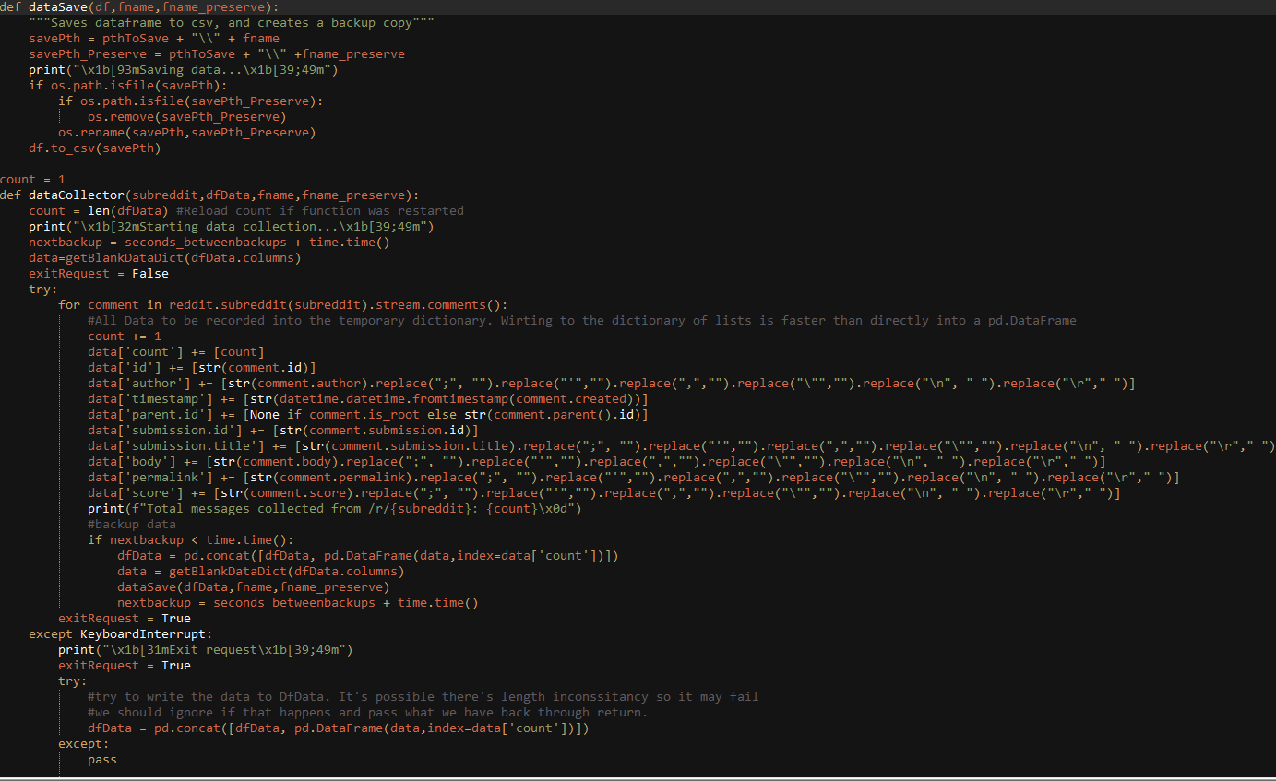
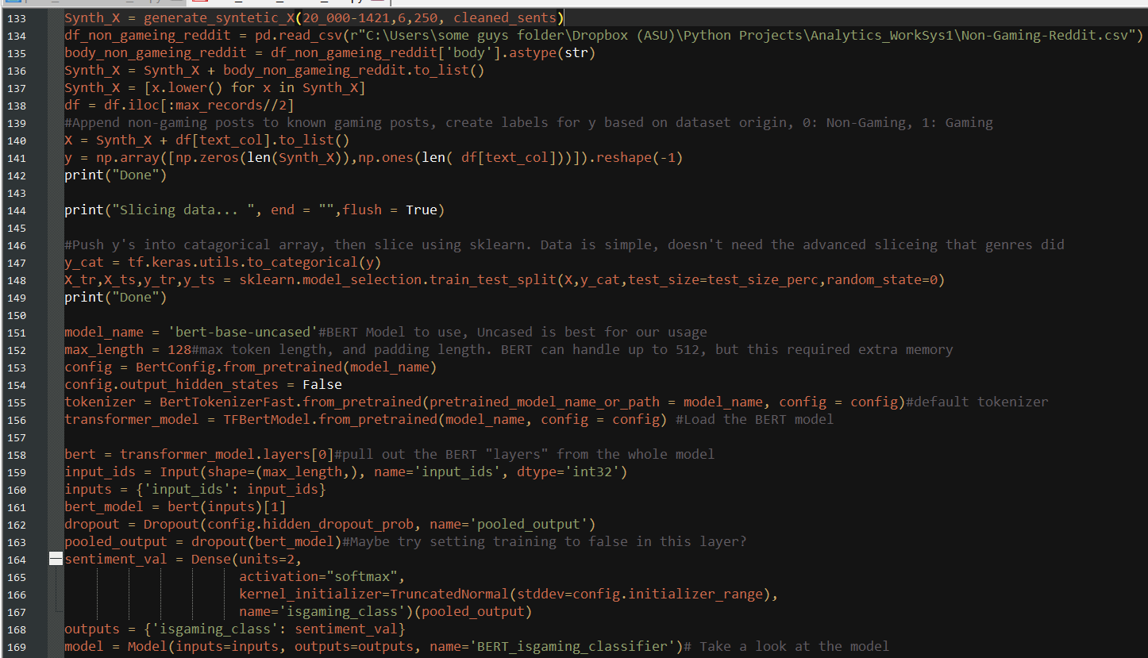
Code Snippets
PRAW Module
BERT Is_Gaming Classifier
Notes:
Some example code our team drew up.
The right is a sample of our modified PRAW crawler.
Key things to note, we wrapped the data collection in it’s own function, which allowed us to do more advanced error handling, such as in the event of an internet outage. Also, using Pandas to store and write the data. This script used an automated back sequence, so data would be preserved between writes in the event of a catastrophic failure.
The left is one of our BERT model trainers used to classify if a post is actually gaming related or not.
Key thing to note, we are using the inter most BERT layer of the BERT model. By default, hugging face pulls the whole model which has some layers that need to be altered for our use. We’re limiting token length to 128, which worked well in our testing. Longer lengths may produce better results, but would require more memory and slow training a bit. Something to consider for future models. We chose adam for the optimizer and Categorical Cross Entropy for the loss, both of which worked well and are supported by the literature.

Slide 7
Models used
We used several models to add structure to the unstructured reddit data:
3 Separate BERT based models:
2 for binary classifications:
Is a post gaming related
What is the sentiment of that post
1 for genre categorization, which grouped posts into one of several topic genres.
Topic modeling, again using BERT, though this was not used in the presentation.

Slide 8
Why the model matters
Consider the following review:
“The fact that we havent had an Elder Scrolls game since Skyrim is the biggest gaming disappointment. But.. But... It costs so much more to make games now with all those tools available that can just cross compile across all platforms. Lets face it. The age of gaming has passed. Talented engineers enjoying the technical hurdles they need to overcome to make a great game have passed. Its much easier to make cookie cutter free phone games. Or $80 games full of loot boxes to buy to unlock the full game. I have high hopes for Starfield. But elder scrolls has essentially been watered down from the DnD it used to be. It has instead become a standard RPG that the masses enjoy. Does anyone remember flying?”
VADER | BERT
93% | 2%
Strongly Positive | Strongly Negative

Slide 9
Why the model matters
The simpler VADER model would have you believe this is positive, that gamers want $80 dollar games with loot boxes
Gamers want to fly, not be weighted down
A BERT based approach would have show you that’s wrong, and saved you time and money.
The model matters, you need an expert to help you dreg through all this data and the techniques to mine it so you can focus on what you do best, game design.
You need 1-D Consulting!
VADER | BERT
93% | 2%
Strongly Positive | Strongly Negative

Slide 10
Consider the time
Once our data was collected and processed we analyze it using industry standard tecniques.
Multiple compelling trends became immediately obvious
For example, there is a general trend of negative sentiment towards horror and gory games during the early morning hours (between 12 AM and 5 AM) but an uptick in reception in the late afternoon.
The following slides discusses this and other trends in more detail

Slide 11
Early access is an early failure
Most gamers have poor reception to posts dealing with early access and early access titles.
Data shows most have very low sentiment scores
Selected sentiment data where Early Access was discussed heavily: (Note, less than 50% is negative 0% is completely negative)
3/29/2023 | 21%
3/30/2023 | 2%
3/31/2023 | 0%
4/2/2023 | 0%
Average | 6%
Notes:
Early access was found to be over strongly negative when discussed. There is solid business value to the model, particularly for indie games, but we don’t recommend you talk or reference the Early Access nature of the game, much.

Slide 12
Charts, Weekly
Notes:
Two slides here, the first has a lot of data, the second peels some of that away and focuses on a subset so it’s easier to see.
The second slide shows that gaming sentiment is generally stable across the week. Though, there was a particular dip around 3/31/23. What this means, is the at least over the short term gaming trends seem to be stable, though there could be peaks and valleys that are leverageable if you’re staying aware and using our services. !SELL 1D Consulting!

Slide 13
Charts, Hourly
Notes:
Two slides here, the first has a lot of data, the second peels some of that away and focuses on a subset so it’s easier to see.
The second slide shows that gaming sentiment for some titles is very dynamic over the day:
Adult games, if your game is a little spicy you may find it best to discuses and market it during these particular time frames, as times outside of that are generally received negatively.
Gory and Horror like games show strong negative review sentiment during the later parts of the evening and early morings, likely because people want to sleep, and would rather not have horror on their mind. Focus on advertising and selling these games in the later moring or when people home from work and school.
Adventure and strategy show the opposite trends, people seem to takes more favorably at night. So consider release news on your adventure and strategy game in the evenings.

Slide 14
Future Avenues for Improvement
There is still a lot of data to go over.
We haven’t considered post titles, and the impact that has on the data
Parent-Child links and the deeper relations here
A/B testing on apps and marketing
Much More!
Contract with 1D consulting if you want more!

Slide 15
Key Takeaways
Unstructured data is complex and hard to understand alone.
With the right models we can pull good data.
Training models takes time, and effort
Wrong choices will lead to lost time and resources and are inevitable.
Let 1-D Consulting’s expertise take on this risk for you!
How we present the outputs matters
Understand the actual business value behind the questions being asked
You need to form the right business question to extract value from data mining

Slide 16

Most valuable Team member
Bert, The Muppet character from the TV Show Sesame Street and where the BERT model get’s it’s name from. This Photo by Unknown Author is licensed under CC BY-SA

Slide 17
Sub Redditts we have Looked in this presentation
https://www.reddit.com/r/Gaming
https://www.reddit.com/r/RetroGaming
https://www.reddit.com/r/Steam
https://www.reddit.com/r/GameDeals
https://www.reddit.com/r/PCGaming
https://www.reddit.com/r/IndieGaming
https://www.reddit.com/r/GamingLeaksAndRumours

Slide 18
References
“Indie Game Marketing on a Shoestring Budget.” The Ultimate Resource for Video Game Design, 9 Sept. 2020, www.gamedesigning.org/learn/indie-game-marketing/.
“Video Game Insights - Games Industry Data and Analysis.” Vginsights.com, vginsights.com/insights/article/infographic-indie-game-revenues-on-steam.
Albanese, N. C. (2022, May 14). Multi-class text classification using Bert and tensorflow. Medium. Retrieved April 14, 2023, from https://towardsdatascience.com/multi-label-text-classification-using-bert-and-tensorflow-d2e88d8f488d

